Slide 1
Placement Management System
Web Technology Project
Koushik .M
Puneeth Reddy
Daanish Shariff
Vyshnavi
Anil Mallapa
20241IST0106 20241IST0107 20241IST0108
20241IST0110 20241IST0111
Section: 3IST02
Web Technology

Slide 2
INTRODUCTION
Placement management is an important process in educational institutions that helps students move from academic life to professional careers. It involves planning, organizing, and guiding students to secure suitable job opportunities. The placement department acts as a bridging students and companies by understanding industry needs and preparing students accordingly.
This process includes activities like skill development, resume preparation, communication training, mock interviews, and career counseling. Placement management also arranges campus recruitment drives where companies visit the institution to select qualified candidates. By coordinating with various organizations, the placement team ensures students receive exposure to real-world job requirements and gain confidence.
Overall, placement management plays a crucial role in shaping students’ futures by helping them build their careers, improving their employability, and connecting them with the right professional opportunities.
:

Slide 3
OBJECTIVES
To develop a web-based system that helps colleges manage and automate student placement
activities efficiently.
Description: This system allows students, companies, and administrators to manage placement processes online.
It simplifies registration, job posting, and result tracking while saving time and reducing manual work.
Technologies Used: HTML, CSS, JavaScript, PHP, MySQL
Outcome: An efficient and user-friendly platform for managing campus placements

Slide 4
OBJECTIVE-Benefits
Key Benefits
Time Efficiency: Reduces manual work for placement coordinators.
Data Accuracy: Ensures reliable storage and retrieval of student and company information.
Transparency: Keeps all stakeholders informed about placement activities.
Accessibility: Students and companies can access data anytime through the system.
Better Decision-Making: Supports data-driven insights for improving placement strategies

Slide 5
HOME PAGE
PURPOSE : To simplify and automate the entire campus placement process
The Home Page is the starting point of the Placement Management System.
Provides easy navigation to all modules — Student, Company, and Admin.
Displays welcome message, system overview, and latest announcements.
Includes Login/Register options for different users.
Shows contact details of the placement cell for quick support.
Designed with a simple and user-friendly interface for smooth access.

Slide 6
Login and Registration
Registration module collects essential user details and creates a unique account.
Login module verifies credentials and provides access to respective dashboards.
Ensures data security and prevents unauthorized access.
Supports role-based access control — each user has specific features and permissions.
Provides password recovery and profile management options.
Allows students, companies, and administrators to securely access the system.

Slide 7
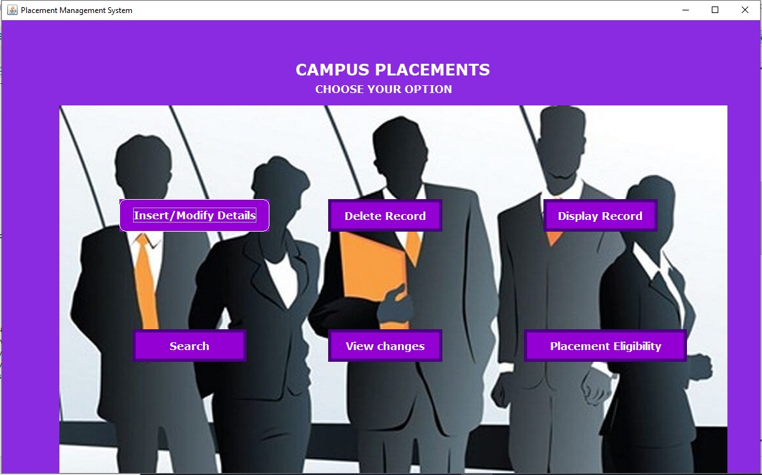
Proposed System
The proposed Placement Management System is a web-based centralized platform designed to automate and simplify the entire placement process. It allows administrators, students, and recruiters to access the system from anywhere, ensuring smooth coordination among all users. The system maintains all records digitally, eliminating the need for manual paperwork and reducing the chances of errors. It enables quick data retrieval, efficient scheduling of placement drives, and real-time communication between students and placement officers. Overall, it enhances transparency, saves time, and improves the overall efficiency of
the placement management process.

Slide 8
Technologies Used
ThePlacement Management Systemis developed using modern web technologies
to ensure better performance, security, and user experience.
Frontend: HTML, CSS, and JavaScript are used to design and build an interactive and responsive user interface.
Backend: PHP / Python / Node.js is used to handle server-side logic, data processing, and communication with the database.
Database: MySQL is used to store and manage all records, including student, company, and placement information securely.
Tools & Environment: XAMPP is used for local server setup, Visual Studio Code for development, and any modern web browser for testing and accessing the system.

Slide 9
Database Design
The database design: of the Placement Management System defines the structure and relationships among key entities to ensure smooth data storage and retrieval.
Student: Stores student details such as name, roll number, department, CGPA, and skills.
Company: Contains information about companies, job roles, and eligibility criteria.
Placement: Records details of placement drives, interview schedules, and results.
Admin: Manages all operations, including student, company, and placement data.
Relationships: Student → Placement (Many-to-One): Multiple students can participate in a single placement drive.
Company → Placement (One-to-Many): A single company can organize multiple placement drives. This structure ensures efficient data management and supports quick access to placement-related information

Slide 10
Screens / Pages
The Placement Management System includes the following main pages Login Page. Allows admin, students, and companies to log in securely.
Dashboard Page – Displays quick access to modules and key information.
Student Profile Page – Shows student details, eligibility, and applied jobs.
Company Registration Page – Lets companies register and post job openings. Placement Drive Page – Displays upcoming drives, schedules, and results.

Slide 11
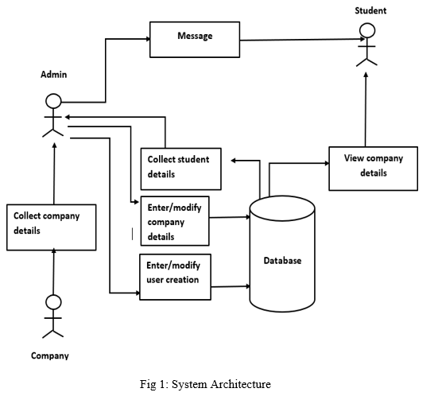

Slide 12
Conclusion
The Placement Management System simplifies and automates the entire campus recruitment process.
It ensures transparency, efficiency, and easy accessibility for students, companies, and administrators.
Future Scope: Integration of a mobile application for better accessibility. Implementation of AI-based job recommendations for students.
Real-time notifications and analytics for improved decision-making.

Slide 13

Thank You

